Slide 1

Google Street View and Image Recognition Yifan Yang 40038814

Slide 2

Google Street View Overview
Google Street View is a technology that provides interactive panoramas from positions along many streets in the world. It was launched in 2007 in several cities in the United States, and has since expanded to include cities and rural areas worldwide. [1]
Along Public Road
Car number plate and Human faces blurred
Sensitive government and military facilities removed

Slide 3
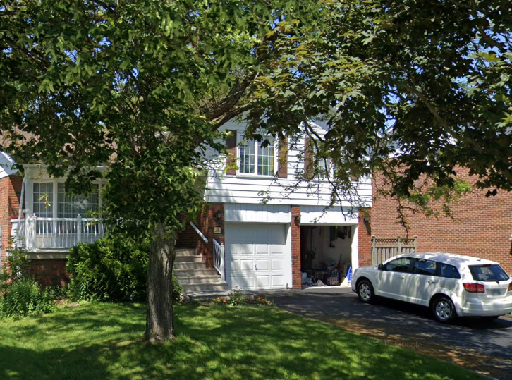
Private residence
Private residence means any building, buildings, or part of a building owned by a private entity which serves as a permanent residence where sewage is generated.[2]
[3]

Slide 4

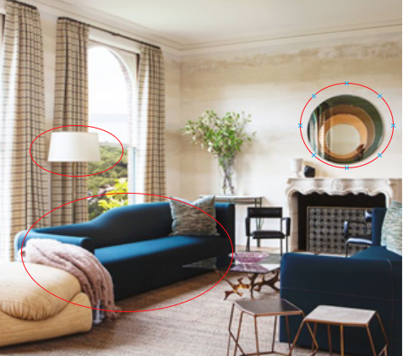
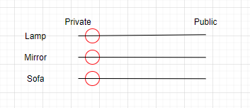
Blur with image recognition
Blurring private residence automatically by default, apply for cancel the blur
[3]
Label: private residence
Extract and identify element
categorize

Slide 5
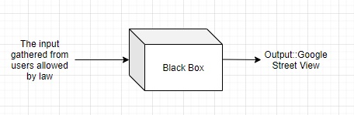
Early Warning
Shallow processing -> Deep processing
Additional law, which gives Google more authority to process data
Black box in coding

Slide 6
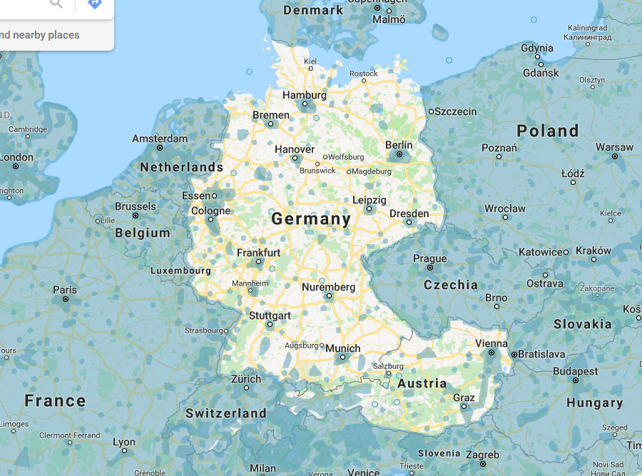
Respect cultural differences
So many people required to blur their houses that the Google manual processing is overloaded, then Google had to close that service
[4]

Slide 7
References
[1] Wikipedia. 2020. “Google Street View” Last modified 4 June 2020. https://en.wikipedia.org/wiki/Google_Street_View
[2] Google Street View. 2020. “12 Kelvinway Dr(Somewhere around this, I just don’t want to be too detailed, that why I said Google Street View needs more privacy for privacy residence)” Last modified June 2019
https://www.google.ca/maps/place/North+Bridlewood+Park/@43.7911158,-79.3210833,3a,53.7y,278.12h,92.83t/data=!3m6!1e1!3m4!1sblq9AU28TEofgNlm5qY5IQ!2e0!7i16384!8i8192!4m5!3m4!1s0x89d4d3b146ac379b:0xa7c5dcefc3645488!8m2!3d43.7910739!4d-79.3194283
[3] Hadley Mendelsohn .2020. “50 Easy Home Decor Ideas That Will Instantly Transform Your Space” Last modified 26 Mar,2020 https://www.housebeautiful.com/home-remodeling/diy-projects/g1242/quick-easy-home-decorating-ideas-0612/
[4]Reddit, 2019. “Germany and Austria vs Google Street View” https://www.reddit.com/r/europe/comments/c2di9j/germany_and_austria_vs_google_street_view/

Slide 8

Thanks for watching!

